Slide 1





Cloud Development Environment
Mentee: Nguyen Quang Tuan
Mentor: Pham Hong Thanh
www.viettel.com.vn
www.viettel.com.vn

Slide 2
Table of content
Introduction to CDE
Why CDE?
CDE Market size
Objectives and tasks
CDE architecture
Big-tech solutions
Eclipse-che
Integrate with Viettel Cloud
Demo
Future works

Slide 3
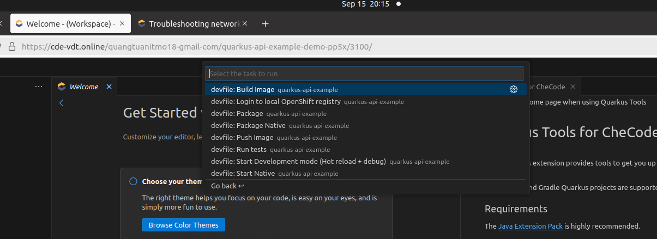
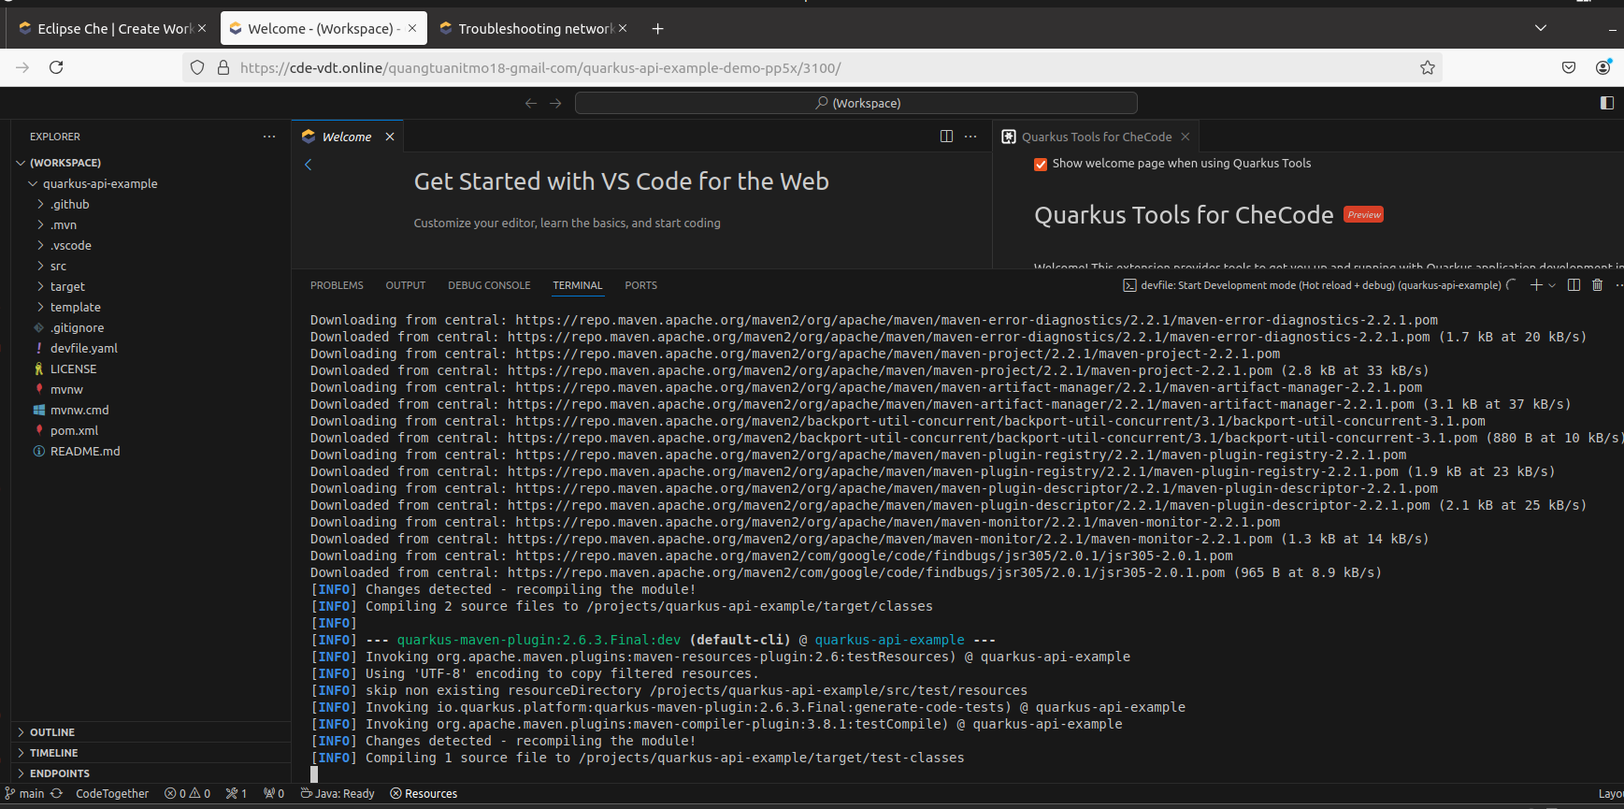

Introduction to CDE
Remote IDE
Use a preconfigured development environment
Contains basic development tools such as IDE, dependencies, git, etc.
Useful for developers work in enterprises or open-source contributor

Slide 4
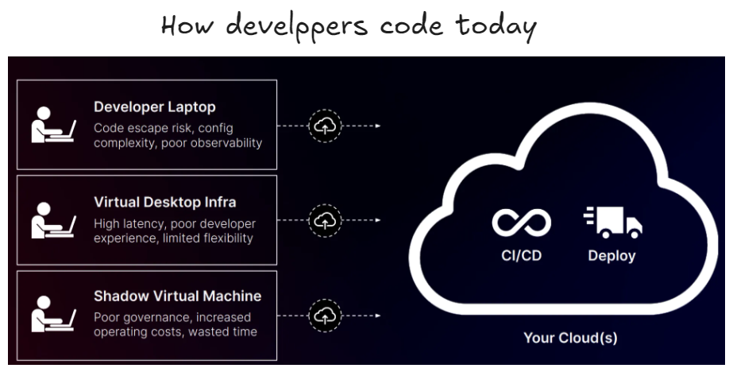
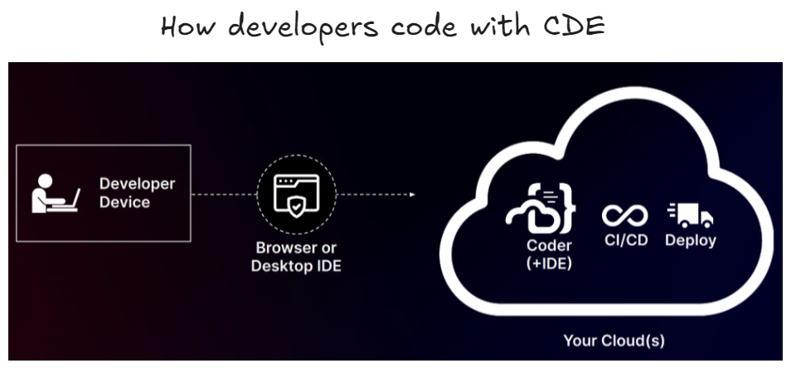
Why cloud development environment?
Configuration Complexity
Poor Observability
Limited Scalability
Low Mobility
=> Cloud solution (cloud development environment)
Time saving
Scalability
Work anywhere
Choose your editor
Easy deployment
[1] What is a Cloud Development Environment? Is it better than localhost?
[2] Why are Cloud Development Environments Spiking in Popularity, Now?
[3] Cloud Development Environments: Everything You Need To Know

Slide 5
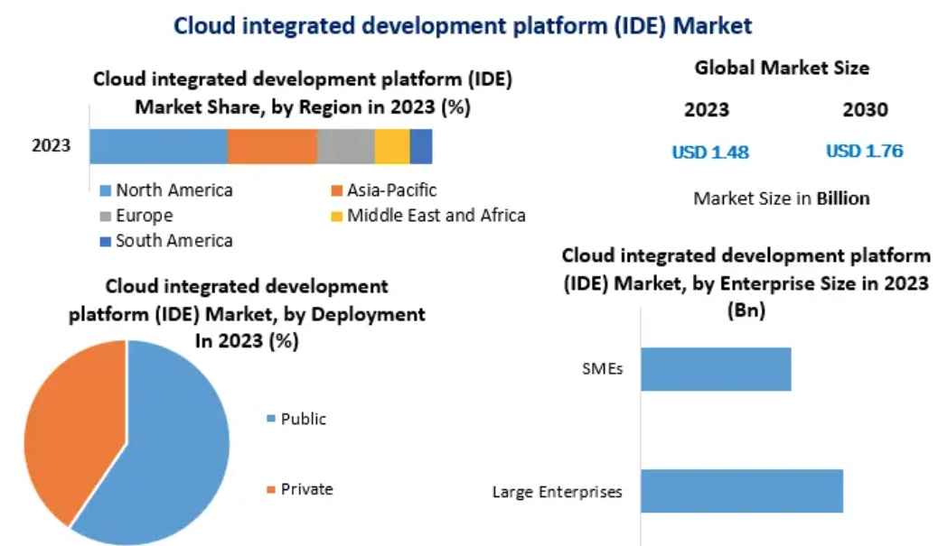
CDE Market
[1] Cloud integrated development platform (IDE) Market: Global Industry Analysis and Forecast (2024-2030)

Slide 6
CDE vs RDP
Criteria | Cloud development environment | Remote desktop protocol
Primary Purpose | Development environment with pre-configured IDEs | Remote access to full desktop (Windows/Linux)
Architecture | Runs on containers/VMs, optimized for development with auto-scaling and shared resources | Access to cloud-hosted desktop with full control
Development Tools | Pre-configured tools (IDEs, Docker, Git) | User installs tools on remote desktop
Performance | Low latency, optimized for coding | Limited scalability compared to CDE
Scalability | Easily scales with containerized environments | Can scale via additional remote desktops but typically less dynamic than CDE scaling
App Setup | Pre-installed tools, quick setup | Manual setup of tools required
Mobility | Accessible via browser, OS-independent | Needs RDP client, device-dependent access
Cost | Pay-as-you-go, cost-effective for short-term use | Higher costs due to full machine provisioning
User Experience | Optimized coding experience with instant setup | Full desktop experience, less coding optimization
Collaboration | Low latency, optimized for coding | Limited scalability compared to CDE
Flexibility | Highly flexible, integrates with CI/CD pipelines and cloud services | Full desktop flexibility, but harder to automate and integrate into modern cloud-native development pipelines

Slide 7

Objectives and tasks
Research, build a solution set and package tools, deploy the Cloud Development Environment platform.
Propose solutions to improve, expand, and integrate the features of the cloud development environment into the Viettel Cloud ecosystem

Slide 8
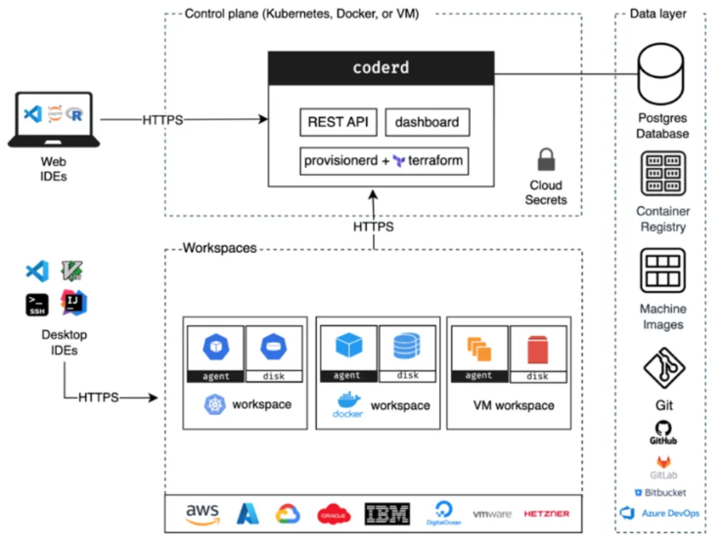
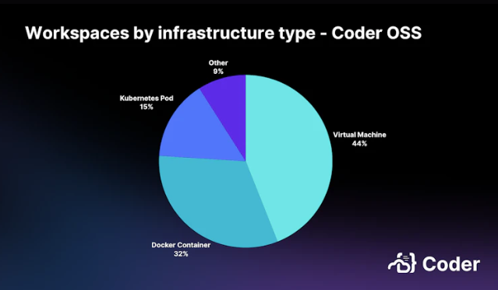
CDE architecture
CDE in Container or Virtual Machine
CDE in Kubernetes
[1] Reference Architectures for CDEs: Kubernetes vs. VMs

Slide 9
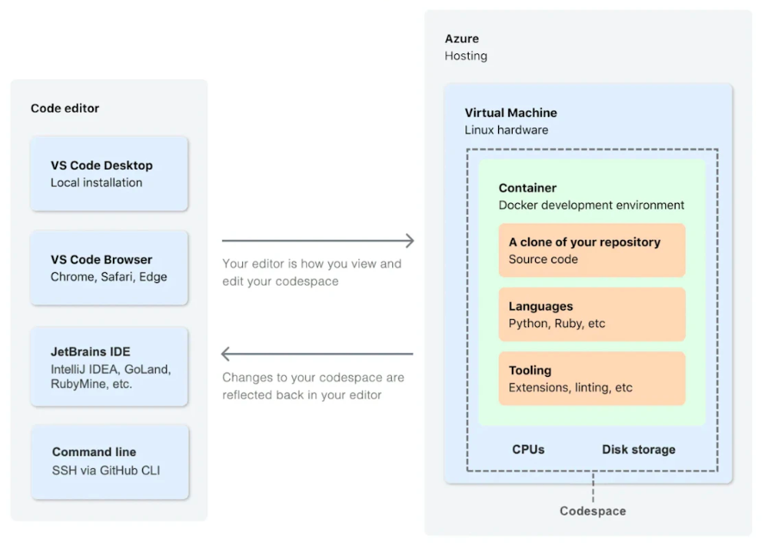
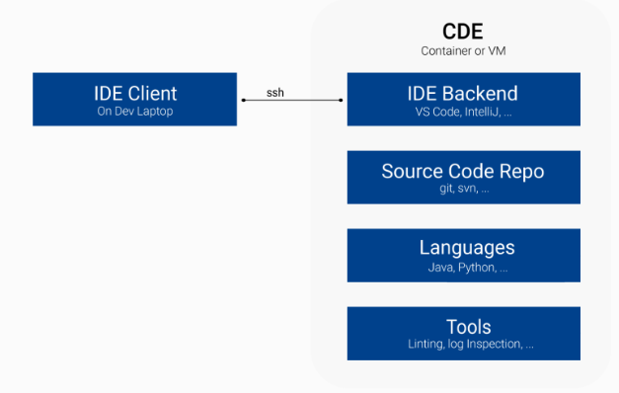
CDE architecture
CDE in Container or VM
[1] How CDEs work?
[2] GitHub Codespaces overview

Slide 10
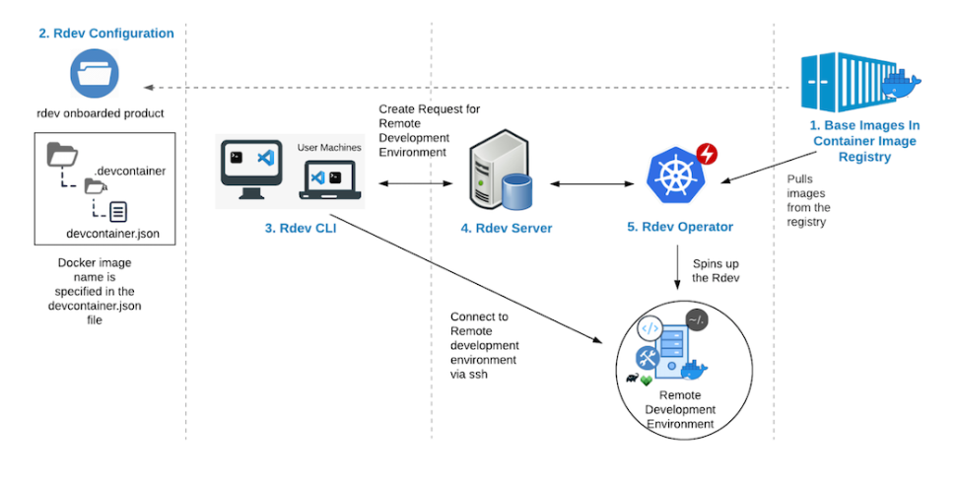
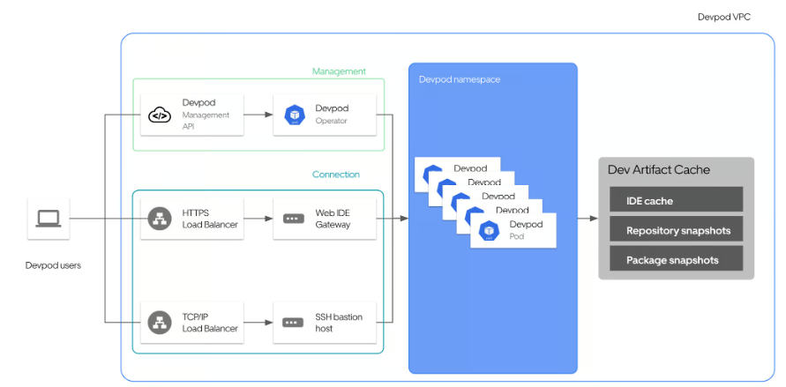
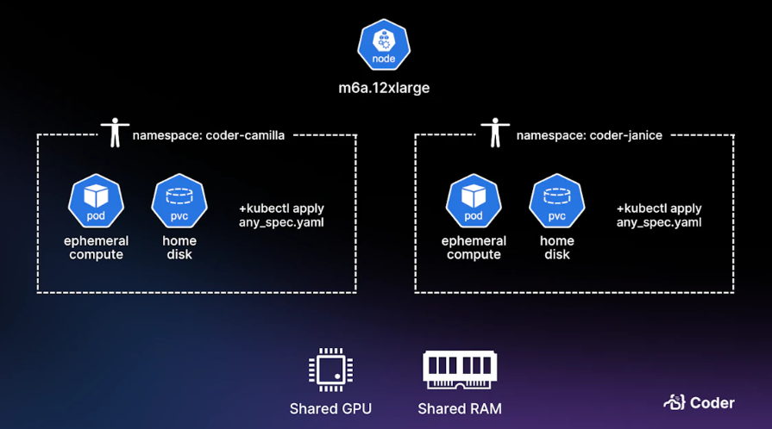
CDE architecture
CDE in Kubernetes
[1] GitHub Codespaces overview
[2] Building in the cloud with remote development

Slide 11
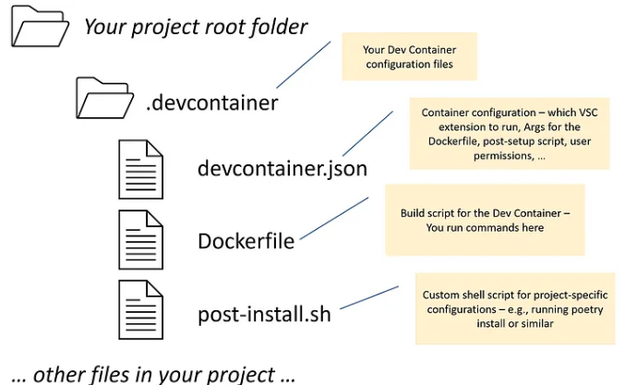
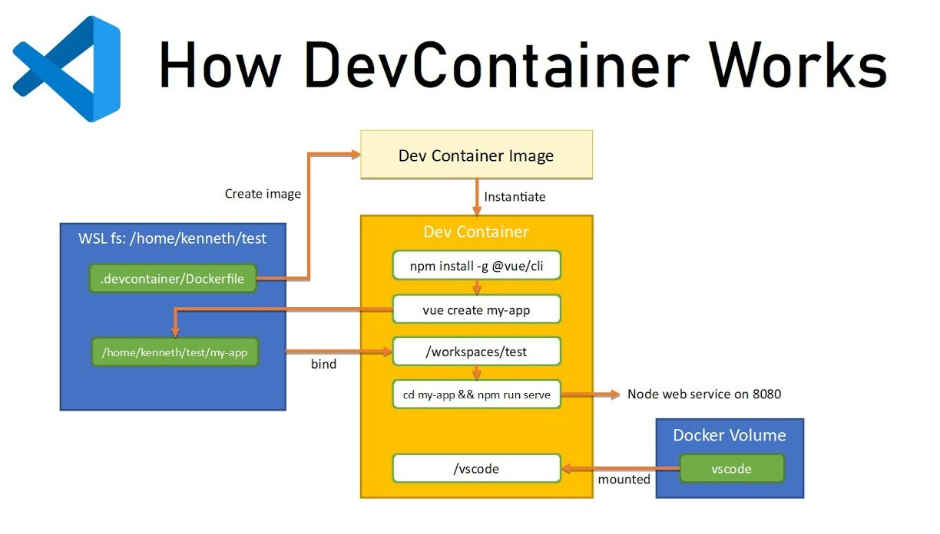
Big-tech solutions
Github codespace
[1] GitHub Codespaces overview
[2] How DevContainer works

Slide 12
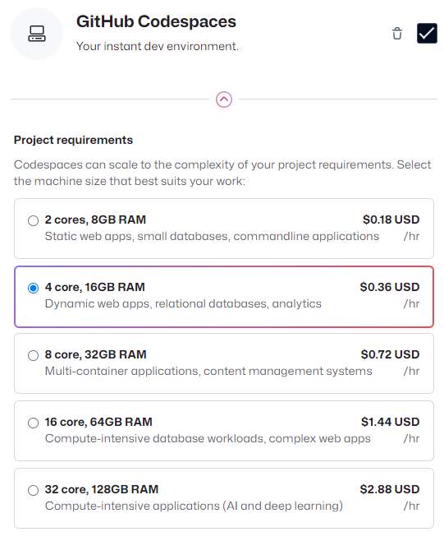
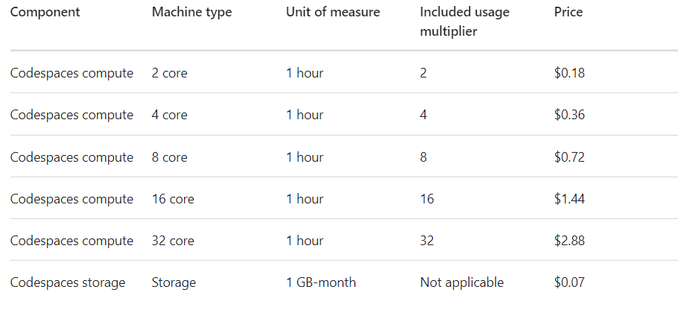
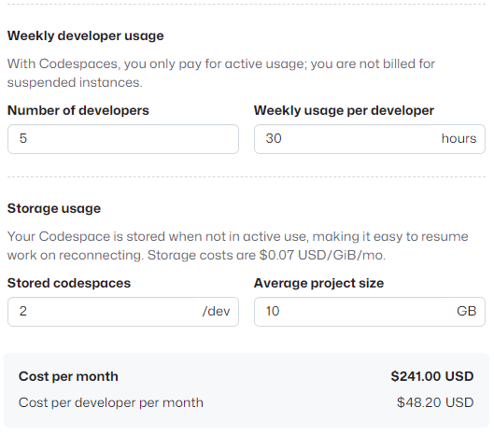
Big-tech solutions
Github codespace - pricing
[1] About billing for GitHub Codespaces

Slide 13
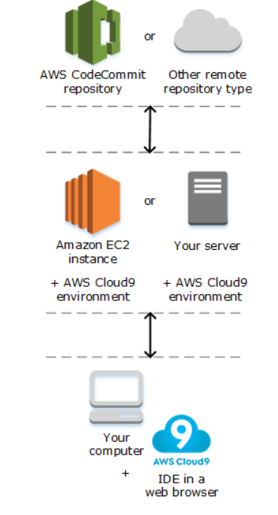
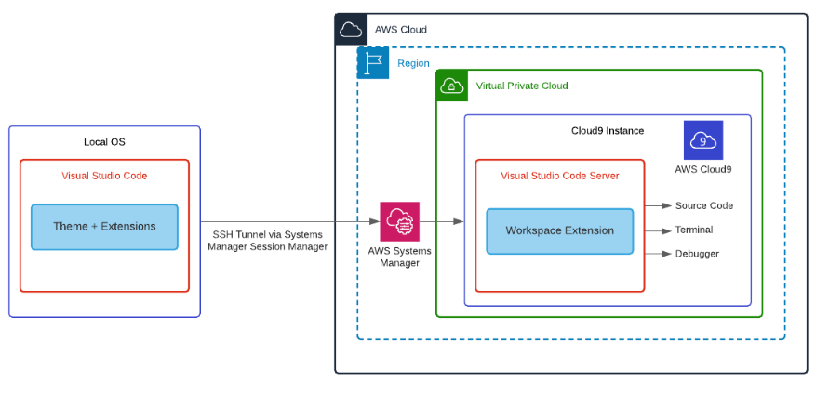
Big-tech solutions
AWS Cloud9
[1] What is AWS Cloud9?
[2] Use AWS Cloud9 to Power Your Visual Studio Code IDE

Slide 14
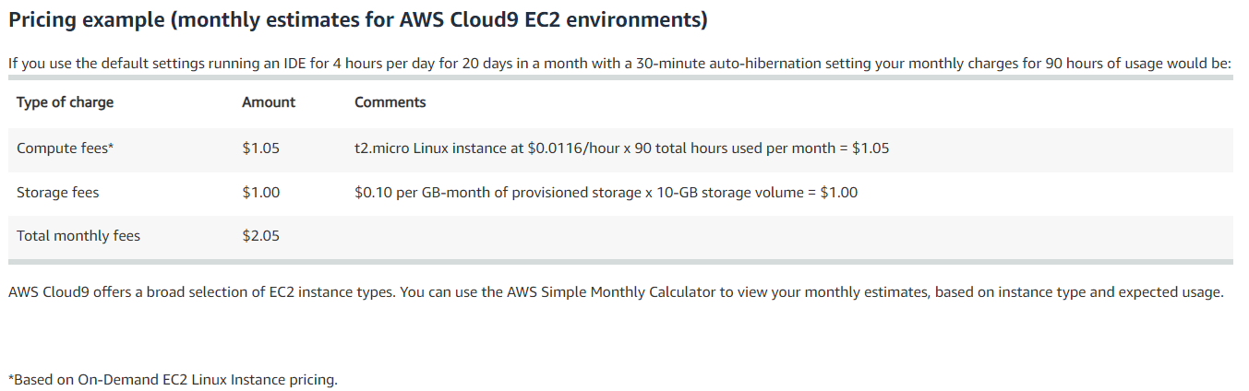
Big-tech solutions
AWS Cloud9 - pricing
[1] AWS Cloud9 Pricing

Slide 15
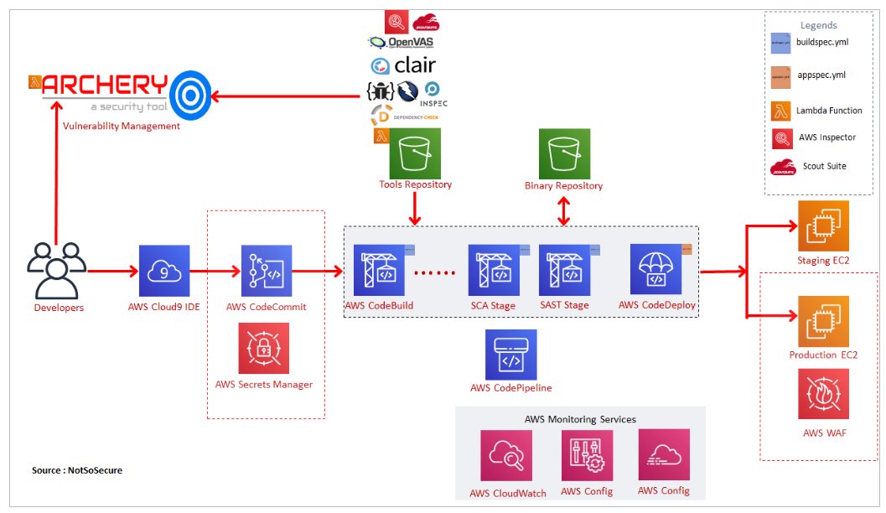
Big-tech solutions
AWS Cloud9
[1] Build a Web App and IDE in AWS
[2] Achieving DevSecOps using AWS Cloud Native Services

Slide 16
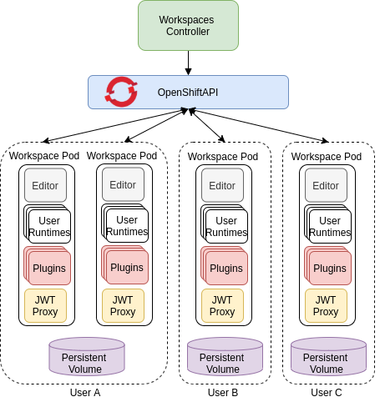
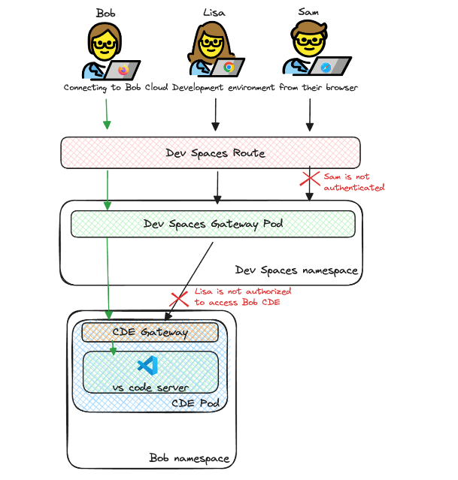
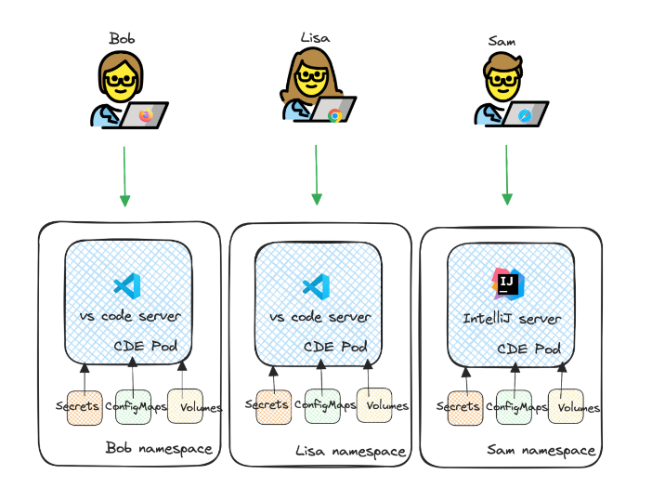


Big-tech solutions
OpenShift Dev Space
[1] CodeReady Workspaces architecture overview
[2] CodeReady Workspaces scales up, is now Red Hat OpenShift Dev Spaces

Slide 17
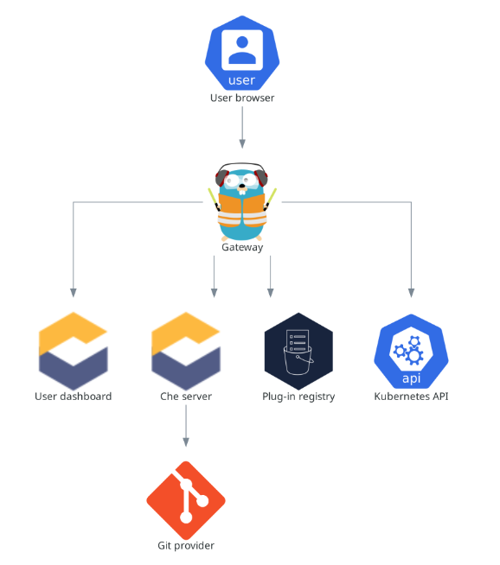
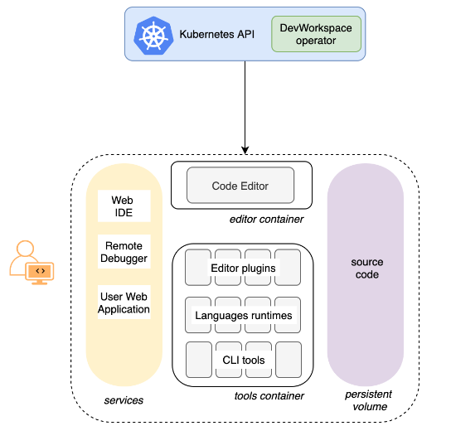
Eclipse-che
DevSpace is a CDE on Kubernetes
RedHat products with EPL 2.0 license
[1] Eclipse-che architecture – User workspaces
[2] Eclipse-che server components

Slide 18
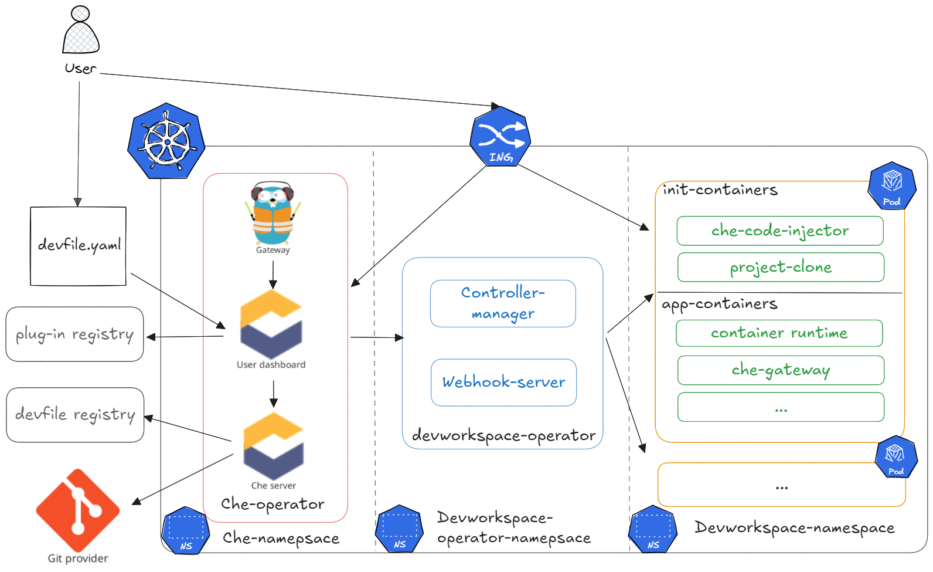
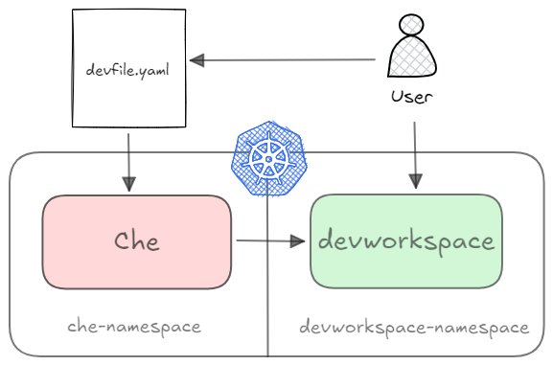
Eclipse-che
Devfile was accepted to CNCF
on January 11, 2022 at the Sandbox maturity level
[1] Eclipse-che – How it works
[2] Devfile

Slide 19
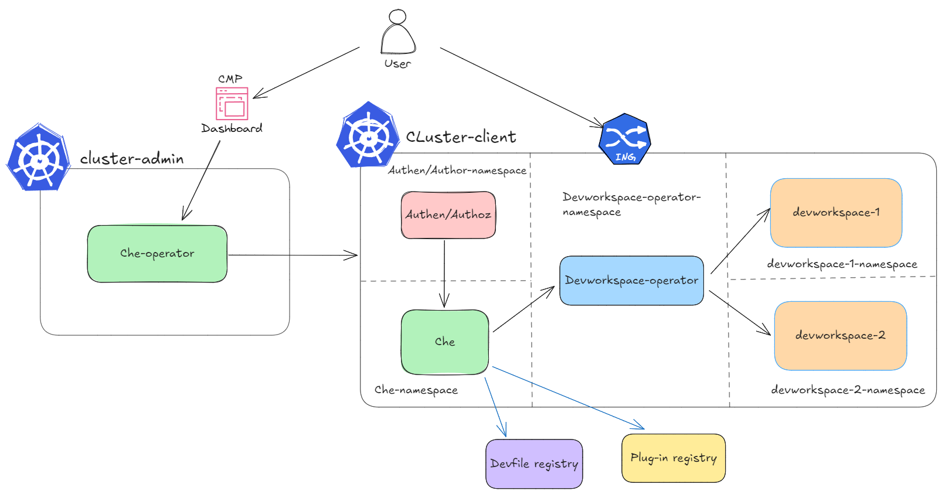
Integrate with Viettel Cloud

Slide 20
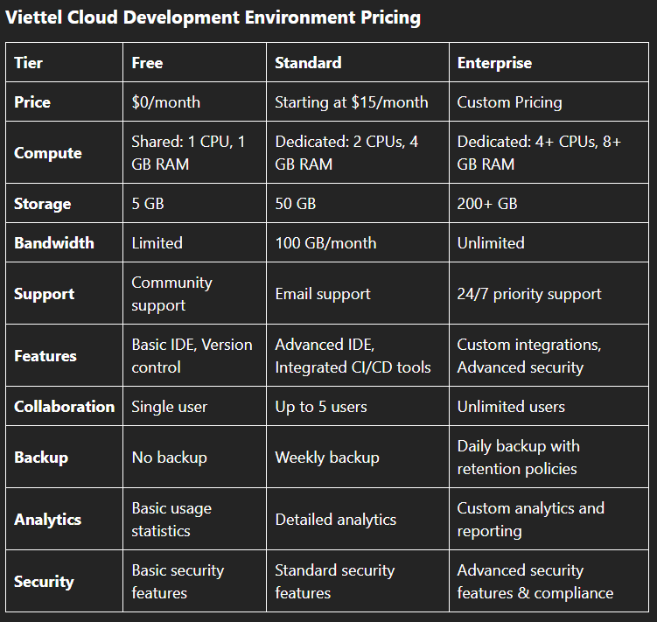
Integrate with Viettel Cloud
Target Audience:
Large enterprises and corporations
Small and Medium Enterprises (SMEs)
Government

Slide 21
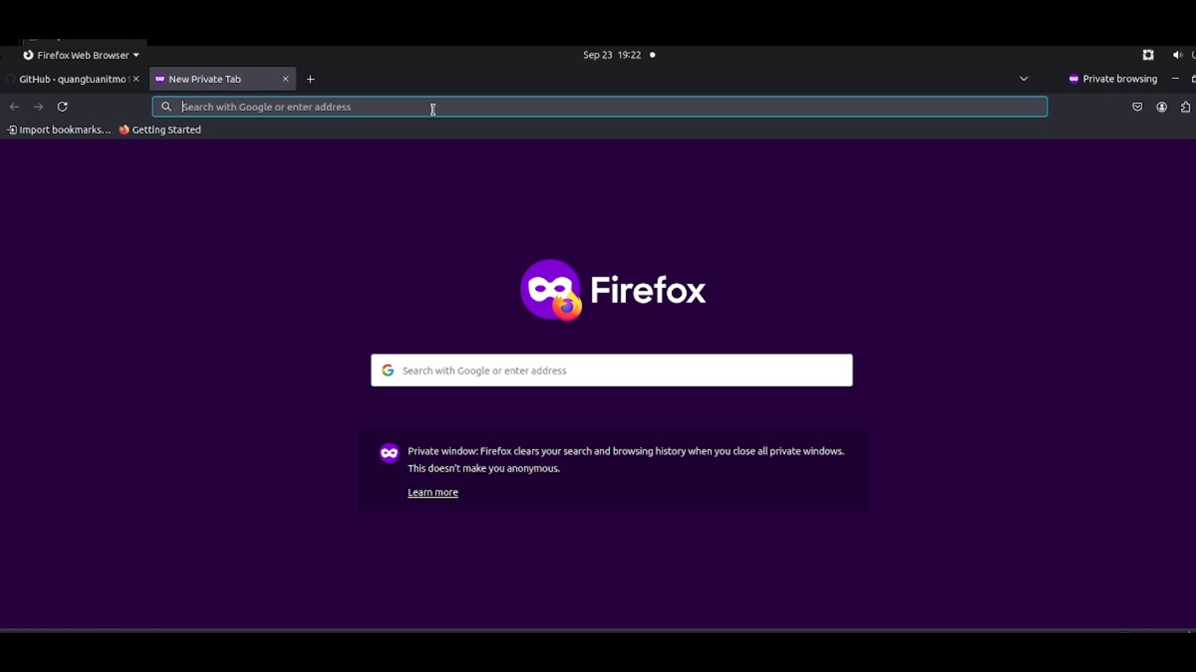
Demo

Slide 22
Discussion
VS code launcher from Eclipse Che is not compatible with containerd
Authentication approach for DevWorkSpace

Slide 23
Future works
Integrate with Viettel Cloud
Improve User Experience (UX/UI)
Integrate with CI/CD and DevOps Tools
Security and Compliance
Custom Development Environments
Enhance Developer Tools

Slide 24
Thank you

